Slide 1
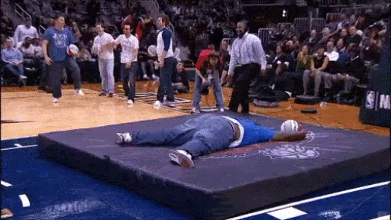
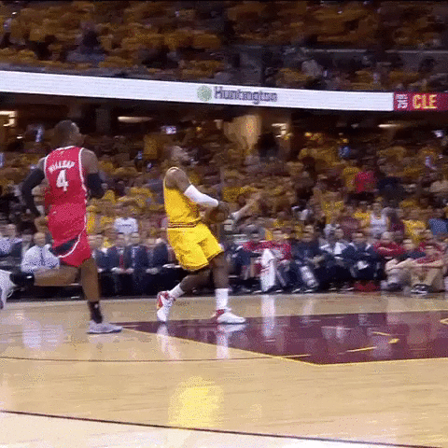
Basketball Fans

Slide 2
Our FAQ
1.- The effect of the age factor in the performance varies depending on the position.
2.- Salary
3.- % de los juegos empezó como titular.

Slide 3
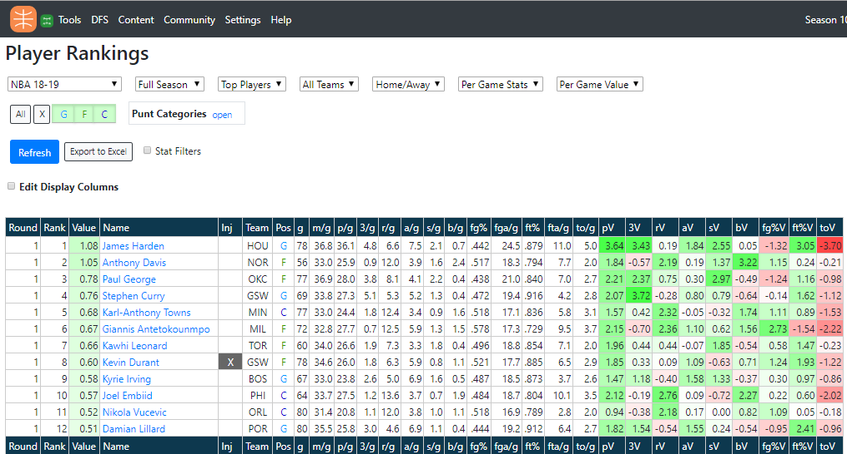

Our data

Slide 4
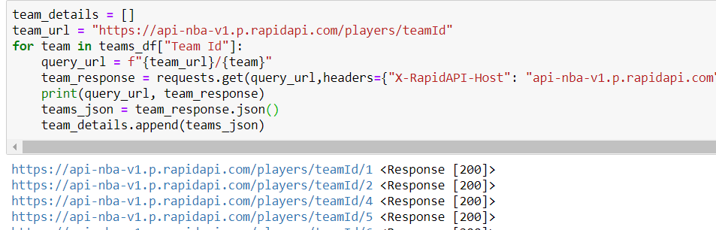
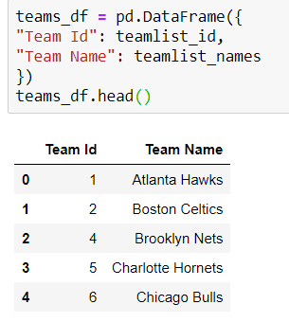
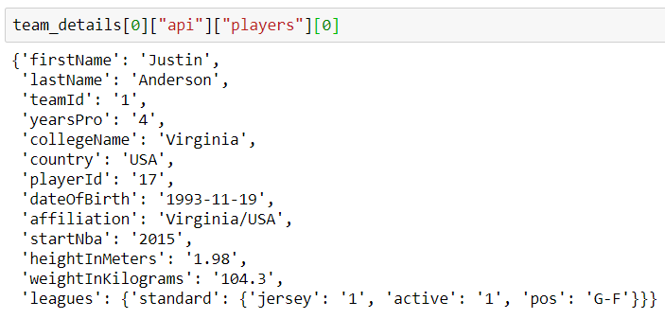
Exploration and Cleanup Process
Notes:
Jan

Slide 5
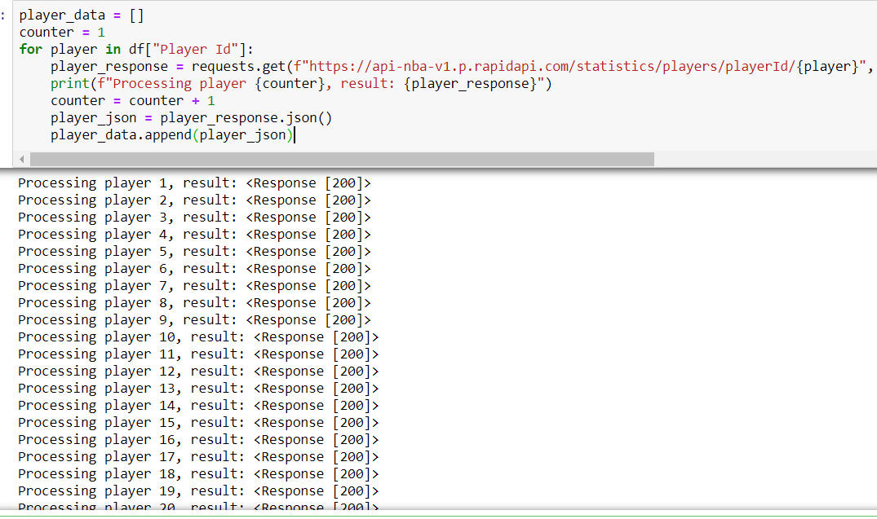
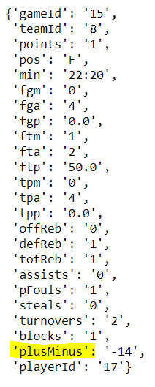
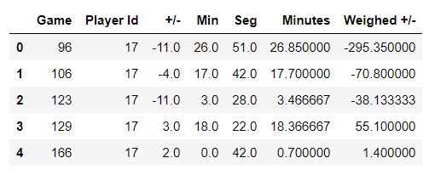
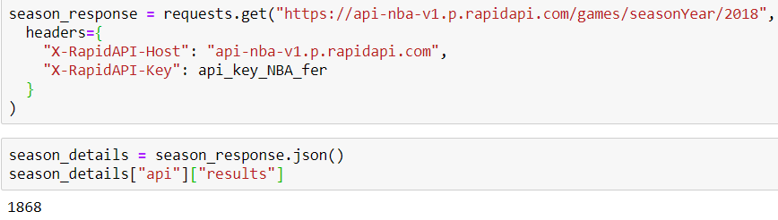
Notes:
Jan

Slide 6
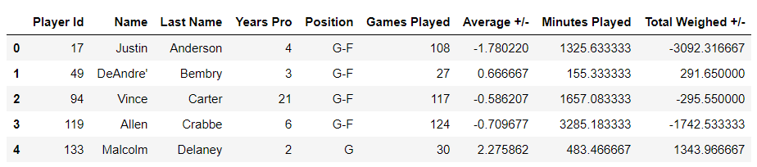
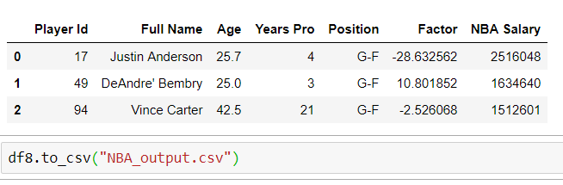
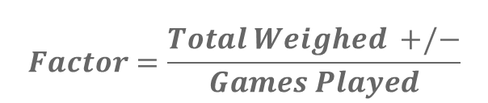
$$Factor=\frac{Total Weighed +/−}{Games Played}$$

Slide 7
Analysis process (jupyter notebook)
Notes:
Diego

Slide 8
Conclusions (numeric summary with jupyter notebook)
** Put the grpahs here
Notes:
Diego

Slide 9
Implications of your findings: what do your findings mean?
1.- The effect of the age factor in the performance varies depending on the position.
2.- Salary
3.- % de los juegos empezó como titular.

